Slide 1
Lecture 29
Monitors
National University of
Computer & Emerging Sciences

Slide 2
Semaphores - Limitations
One has to be really careful while working with the Semaphores
Problem with semaphores:
  Used for both mutex
  and scheduling constraints.
This makes the code hard to read, and hard to get right.
Possible scenarios of incorrect usage
  signal (mutex) …. wait (mutex)
  wait (mutex) … wait (mutex)
  Omitting of wait (mutex) or signal (mutex) (or both)_x0010_

Slide 3
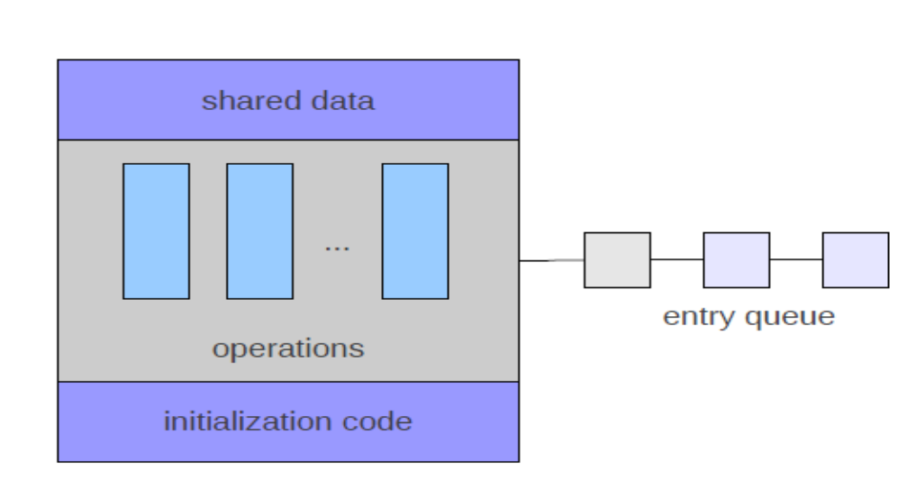
Mutual Exclusion is shifted to Programing language from programmer
A monitor is a programming language construct that supports controlled access to shared data
A monitor is an ADT which encapsulates:
  shared data structures
  procedures that operate on the shared data
  synchronization between concurrent threads that invoke those procedures
Data can only be accessed from within the monitor, using the provided procedures

Slide 4
Monitor
A monitor has four components
  initialization,
  private data,
  monitor procedures,
  and monitor entry queue
A monitor looks like a class with constructors, private data and methods.
  The only major difference is that classes do not have entry queues.
Notes:
The initialization component contains the code that is used exactly once when the monitor is created, The private data section contains all private data, including private procedures, that can only be used within the monitor. Thus, these private items are not visible from outside of the monitor. The monitor procedures are procedures that can be called from outside of the monitor. The . monitor entry queue contains all threads that called monitor procedures but have not been granted permissions.
One can consider the initialization as those data that are initialized when the system is booted up, the private data and code as the internal data structures and functions of an operating system, and the monitor procedures as the system calls. User programs are, of course, threads that make service requests. Therefore, a monitor can be considered a mini-OS with limited services.

Slide 5
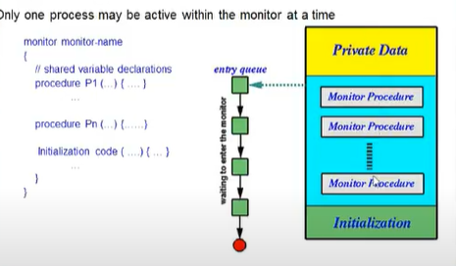
Monitors

Slide 6
Monitor
Monitor: A lock + condition variables
Lock: Provides mutual exclusion to shared data
Condition variable: Provides a queue for waiting threads inside a critical section

Slide 7
A monitor
shared data
waiting queue of threads trying to enter the monitor
at most one thread in monitor at a time
operations (methods)

Slide 8
Monitor - Mutual Exclusion
Lock: provides mutual exclusion to shared data
Monitors guarantee mutual exclusion using lock
  Only one thread can execute a monitor procedure at any time.
    “in the monitor”
  If second thread invokes a monitor procedure at that time
    It will block and wait for entry to the monitor
    Need for a wait queue

Slide 9
Lock
A lock provides two operations:
  Lock::Acquire()
    Wait until the lock is free, then grab it
  Lock::Release()
    Unlock, wake up anyone waiting to Acquire
  A lock is initially free
Always acquire a lock before accessing a shared data structure
Always release the lock after finishing with the shared data structure

Slide 10
Locks: A simple example
AddToQueue() {
lock.Acquire(); // lock before using shared data
put item on queue; // ok to access shared data
lock.Release(); // unlock after done with shared data
}
RemoveFromQueue() {
lock.Acquire(); // lock before using shared data
if something on queue // ok to access shared data
remove it;
lock.Release(); // unlock after done with shared data
return item;
}

Slide 11
Condition variable
We need additional mechanisms to wait inside locked regions
However, holding the lock while waiting prevents other threads from entering the locked region
Condition variables make it possible to sleep inside a critical section
  Atomically release the lock & go to sleep

Slide 12
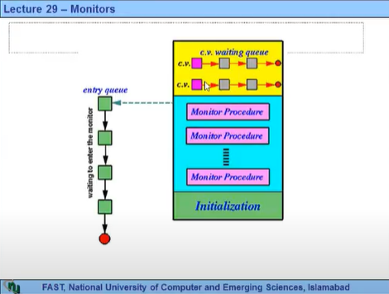
Condition variable

Slide 13
Example: Bounded Buffer Scenario
Produce()
Consume()
Buffer is empty
Now what?

Slide 14
Example: Bounded Buffer Scenario
Produce()
Consume()
Buffer is empty
Now what?

Slide 15
Condition Variables
If a thread must wait for an event, that thread waits on the corresponding condition variable.
If another thread causes an event to occur, that thread simply signals the corresponding condition variable.
Notes:
Thus, a condition variable has a queue for those threads that are waiting the corresponding event to occur to wait on,

Slide 16
Condition variables
A place to wait; “Required” for monitors
Three operations on condition variables
  wait(c)
      release the lock so that some other process can use it
      go to sleep
      Reacquire lock on return
  signal(c)
    wake up at most one waiting thread
    if no waiting threads, signal is lost
      this is different than semaphores: no history!
  broadcast(c)
    wake up all waiting threads
      Atomically release the lock and go to sleep
      Reacquire lock on return

Slide 17
A simple example
AddToQueue() {
lock.Acquire(); // lock before using shared data
put item on queue; // ok to access shared data
condition.signal();
lock.Release();// unlock after done with shared data
}
RemoveFromQueue() {
lock.Acquire();
while nothing on queue
condition.wait(&lock);//release lock;go to sleep;
// re-acquire lock
remove item from queue;
lock.Release();
return item;}

Slide 18
How is a conditional variable different from Semaphore?
Conditional Variables are not counters
Just unblock a thread if one is blocked on the conditional variable
No counter incremented/decremented
Just like Sleep/Wakeup except that this is atomic
That's why they must be accessed in a critical section
Before waiting, must check the state variables.

Slide 19
Producer/Consumer Problem with Monitor
Constraints
  1. Producers can produce if buffer not full
    Condition: okToProduce
  2. Consumers can consume if buffer not empty
    Condition: okToConsume
  3. Only one thread manipulates state variables at a time.

Slide 20
int empty = BUFFER_SIZE;
void producer(void) { int item;
while(TRUE) {
produce_item(&item);
mutex->lock();
while(empty < 0)
okToProduce->Wait(&mutex);
enter_item(item);
empty--;
okToConsume->Signal();
mutex->unlock();}}
void consumer(void) { int item;
while(TRUE) {
mutex->lock();
while(empty > BUFFER_SIZE)
okToConsume->Wait(&mutex);
remove_item(&item);
empty++;
okToProduce->Signal();
mutex->unlock();
consume_item(&item);}}

Slide 21
Semaphores vs Condition Variables
Semaphores | Condition Variables
Can be used anywhere in a program, but should not be used in a monitor | Can only be used in monitors
Wait() does not always block the caller (i.e., when the semaphore counter is greater than zero). | Wait() always blocks the caller.
Signal() either releases a blocked thread, if there is one, or increases the semaphore counter. | Signal() either releases a blocked thread, if there is one, or the signal is lost as if it never happens.
If Signal() releases a blocked thread, the caller and the released thread both continue. | If Signal() releases a blocked thread, the caller yields the monitor (Hoare type) or continues (Mesa Type). Only one of the caller or the released thread can continue, but not both.

